Slide 1
Food Production and Consumption Patterns in Namibia
Secondary analysis of NHIES 2015/16 data to support the design and implementation of national food and nutrition policies
13 October 2020

Slide 2
Overview
Background
Methodology
Key Findings
Appendix: Summary of Methods

Slide 3
I. Background
The Food and Nutrition Security Policy and Implementation Action Plan (2019-2024) includes strategies to implement and strengthen mandatory fortification of staple foods and condiments.
Data and analyses on food production and consumption within households are required to appropriately inform the design and implementation of food and nutrition security policies.
From April 2015 to March 2016, the Namibia Statistics Agency undertook the Household Income and Expenditure Survey (NHIES).
The survey collected valuable information on household food production and consumption throughout the country, including a 7-day food diary.

Slide 4
II. Methodology
To better understand the household food production and consumption patterns within Namibia, a series of analyses were performed:
Analysis of household-level food consumption¹ and grain production² according to key demographics;
Comparison of regional cereal production data from MAWF, NAB and NHIES;
Mapping of regional and temporal variations in household-level grain consumption.
¹ Wheat, other cereal, rice, oil, and spices.
² Maize, mahangu (millet), sorghum, wheat, and other grains

Slide 5
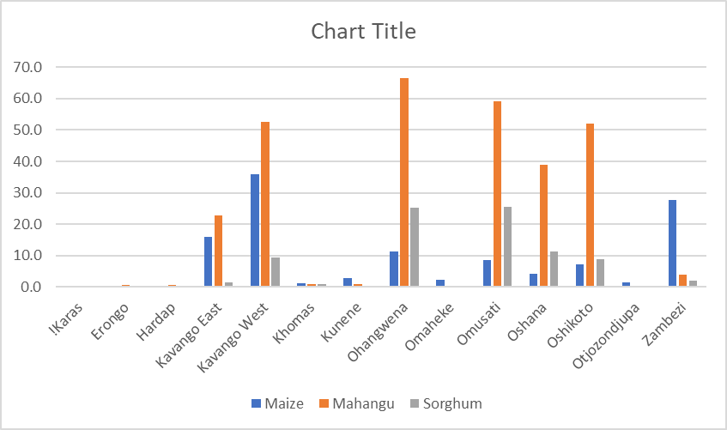
III. Key Findings
A. Analysis of household-level food consumption and grain production
Mahangu (millet), sorghum, and maize were grown by 45, 14, and 12 percent of NHIES rural households, respectively.
The regions with the highest proportion of households growing each grain are shown in Figure 1.

Slide 6
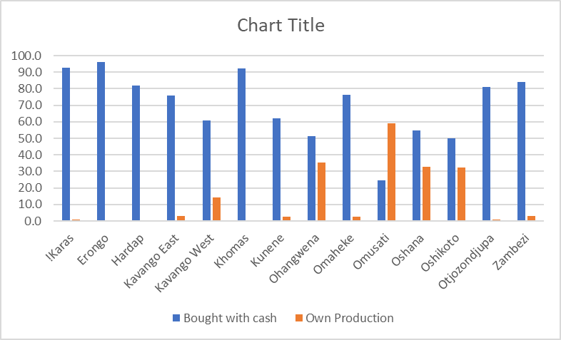
III. Key Findings
A. Analysis of household-level food consumption and grain production
A large majority of households in the NHIES 2015/16 reported consuming “other cereals”, in addition to wheat flour/bread and rice, in the week prior to the survey (82 percent).³
The main source of these “other cereals” varied by location, income, and ethnic group:
Households in regions with low overall grain production more often purchased “other cereals”; in contrast, more than 1 in 3 households in Ohangwena, Omusati, Oshana, and Oshikoto reported consuming them from their own production.
Nine out of 10 households in the highest income bracket (87 percent) reported buying these “other cereals” with cash compared to just 59 percent of households in the lowest bracket.
³ See Appendix for limitations of this analysis.

Slide 7
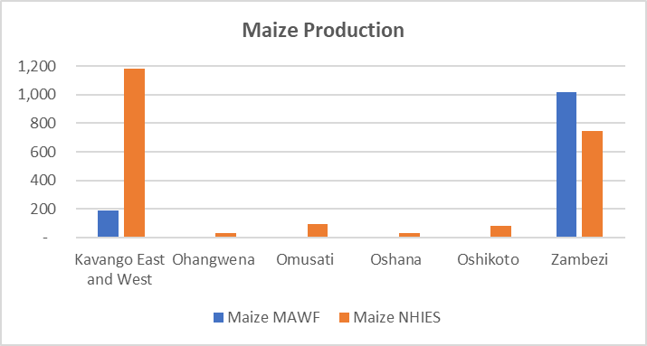
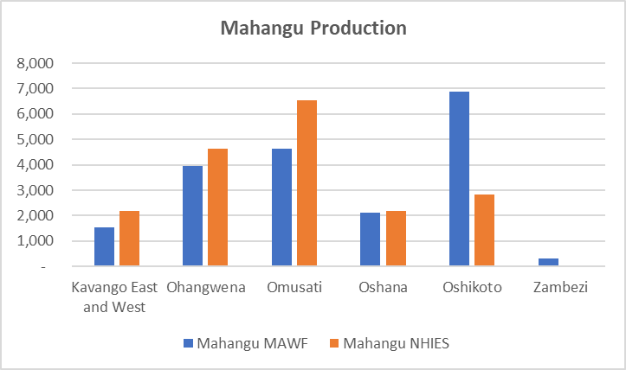
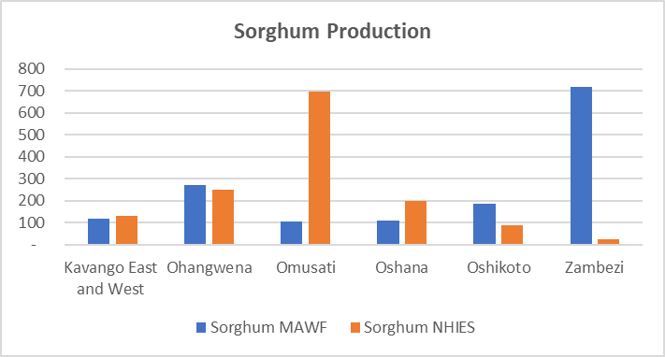
III. Key Findings
B. Comparison of regional cereal production data from MAWF, NAB and NHIES
Estimates of regional crop production (MT) from NHIES correlated reasonably well with communal crop production data collected by MAWF.

Slide 8
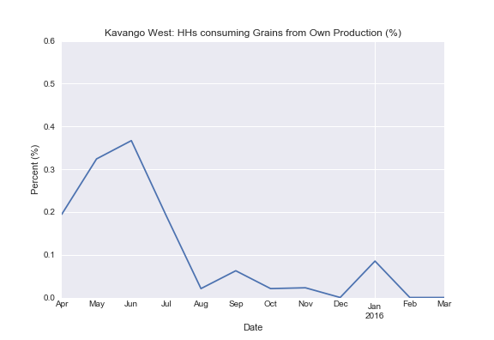
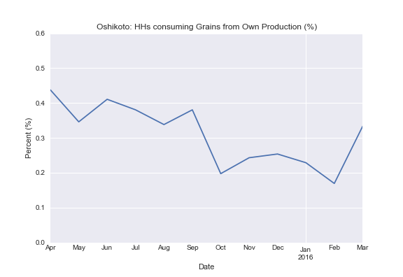
III. Key Findings
C. Mapping of regional and temporal variations in household-level grain consumption
Household consumption of “other cereals” from own production as recorded in the household file was highest during and following the main harvest period (May-August).
³ See Appendix for limitations of this analysis.

Slide 9
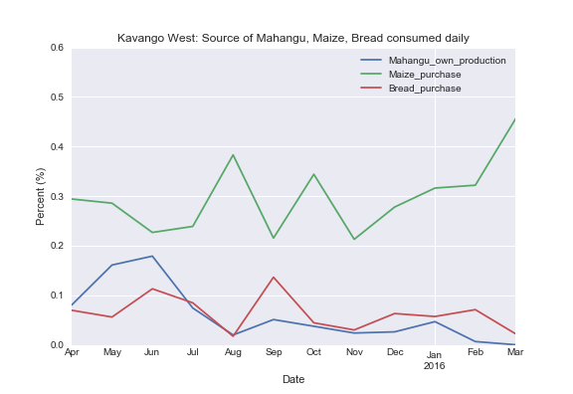
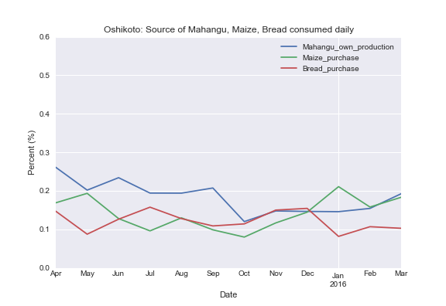
III. Key Findings
C. Mapping of regional and temporal variations in household-level grain consumption
Using the DRB file, incidence of mahangu consumption from own production follows a similar pattern. However, consumption of purchased maize and bread also remain significant even in high mahangu-producing regions.

Slide 10
IV. Appendix: Summary of Methods
All analysis files, dependencies, source code and charts/graphs can be found on GitHub.

Slide 11
A. Analysis of household-level food consumption and grain production according to key demographics
Data Sources: NHIES 2015/16 Household Dataset file
Materials: Python 3.8
Analysis Process: Weighted frequencies and means were calculated for variables of interest from Sections 2E and 7 of the household questionnaire.
Limitations: The household dataset/questionnaire did not allow analysis of consumption by specific grain type (e.g., maize, mahangu, and sorghum) – these were all lumped together under the “other cereals” category in Section 2E.

Slide 12
B. Comparison of regional cereal production data from MAWF, NAB and NHIES
Data Sources: NHIES 2015/16 Household Dataset file; MAWF regional crop production data; NAB commercial and import data; Namibia Inter-censal Demographic Survey
Materials: Python 3.8
Analysis Process: Twenty years of regional (communal) crop production data were obtained from MAWF. Ten years of import and commercial crop production data were sourced from NAB and annual reports. To calculate regional production estimates from NHIES data, the weighted median amount grown in each region was multiplied by the % of households growing the crop and the number of households in the region according to Inter-censal Survey 2016.
Limitations: MAWF only collects/records maize crop production estimates for high-production regions (East and West Kavango, Zambezi) making comparison with other regions impossible. NHIES likely captured at least one large-scale (or commercial) maize and mahangu operation. Medians were used to minimize the impact of these outliers. NHIES data also relies on household reports whereas MAWF uses crop cuttings to support estimates.

Slide 13
C. Mapping of regional and temporal variations in household-level grain consumption
Data Sources: NHIES 2015/16 Household Dataset file and Daily Record Book Dataset file
Materials: Python 3.8
Analysis Process: A clean survey date variable [start_date] was created based on [ah_start_date] from the household file. The household dataset was then sorted according to this variable and implausible entries removed (i.e. before April 2015). The dataset was then grouped by month and region and the weighted mean of households reporting consuming “other cereals” from own production was calculated.
For the DRB analysis, the same date variable was used (merged into DRB file on HHID) and the same grouping process applied. However, the DRB contains counts of food items consumed over a 7-day period; therefore, the denominator is NOT total households (as above) but total number of food items consumed over a 7-day period.
Limitations: The NHIES 2015/16 started and ended data collection just before harvest season which makes visualization of seasonal consumption trends slightly more difficult.

